Slide 1
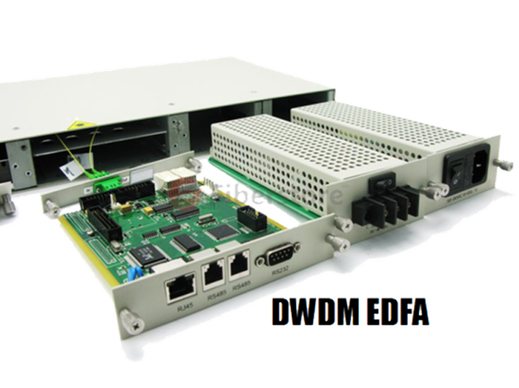
Erbium Doped Fiber Amplifier
GROUP 4
Nguyen Quang Huy-20131772
Pham Duc Hoang-20131539
Pham hoang minh-20132610

Slide 2

Erbium-Doped Fiber Amplifier, C-Band (EDFA-C-R)
Obtilab
Input Range: -12dBm to 7dBm
Output Range: 18dBm to 26 dBm
Optical Gain: up to 30dB

Slide 3
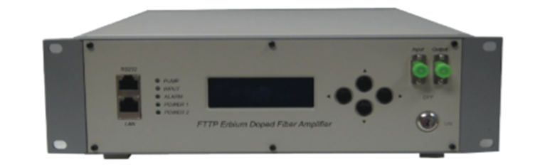
Inline Erbium-Doped Fiber Amplifier(EDFA-I-B)
Obtilab
Input Power Range: -15 dBm to 5 dBm
Output Power Range: 18 dBm to 25 dBm
Gain: Up to 40 dB

Slide 4

Erbium-Doped Fiber Amplifier, Benchtop (EDFA-C-B)
Obtilab
Input Range: -12 to 7 dBm
Output Range: 18 to 26dBm
Optical Gain: Up to 45dB

